Slide 1
What is AI ?

Slide 2
????

Slide 3
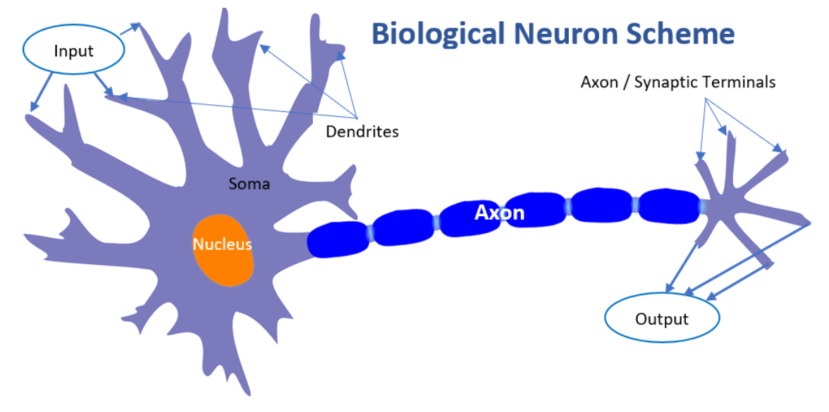
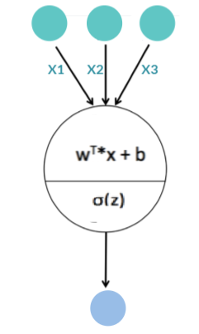
Neural Network
Inspiration - The Biological Neuron Model

Slide 4
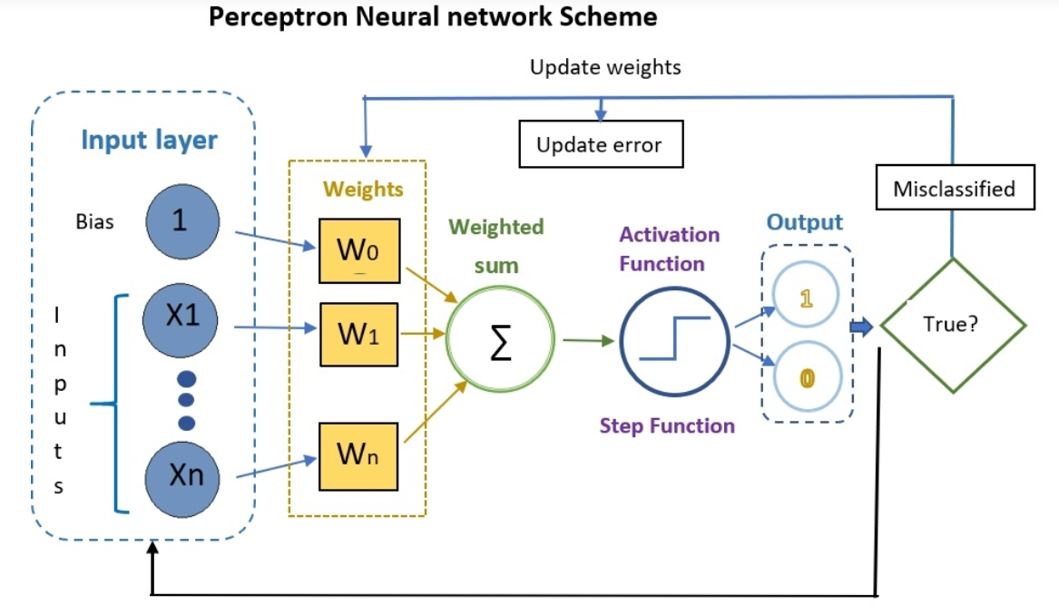
Learning Weights

Slide 5
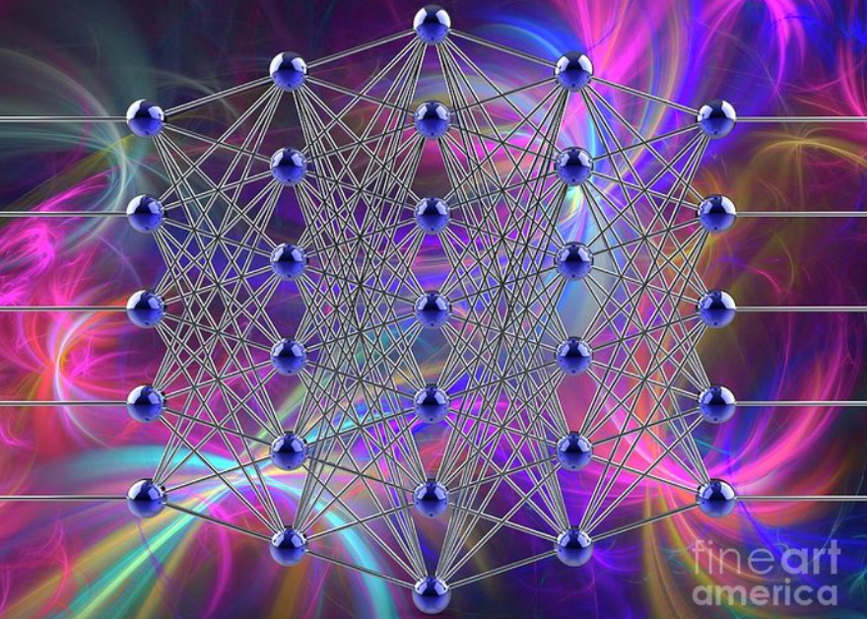
Deep Learning

Slide 6
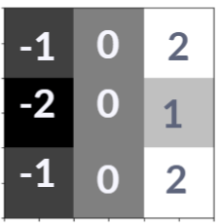
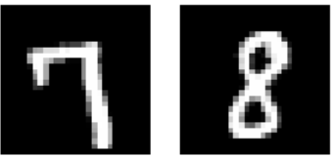
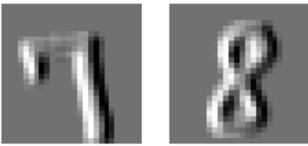
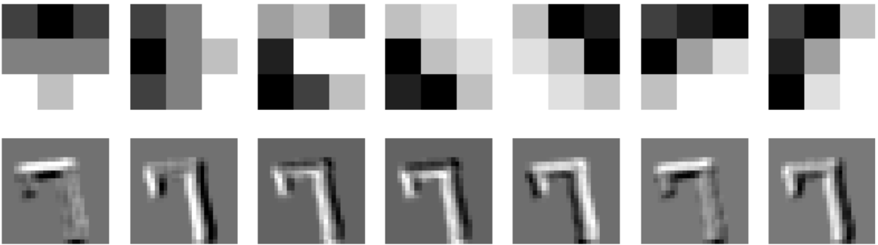
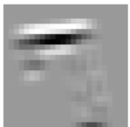
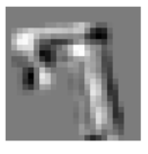
How the network see ?

Slide 7
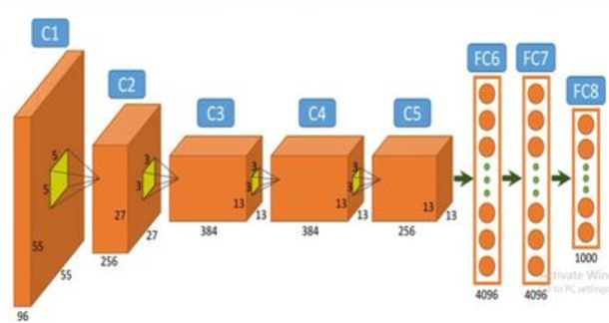
Convolution Network
Alex Net

Slide 8
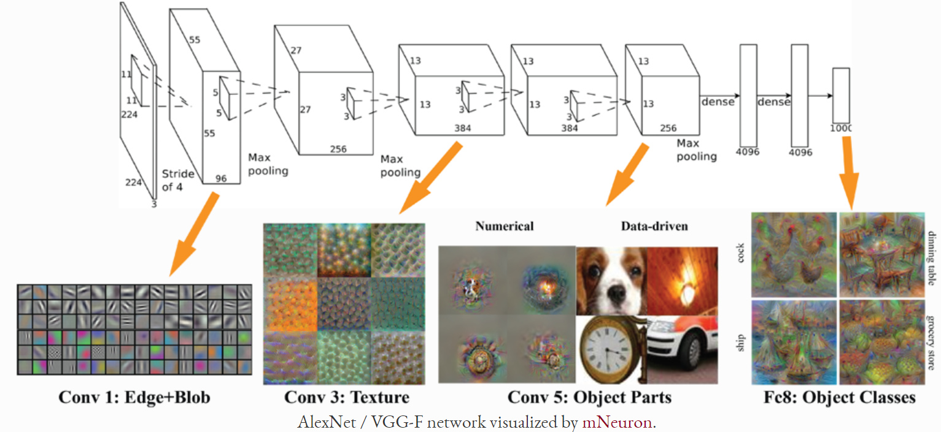
Trained Models

Slide 9
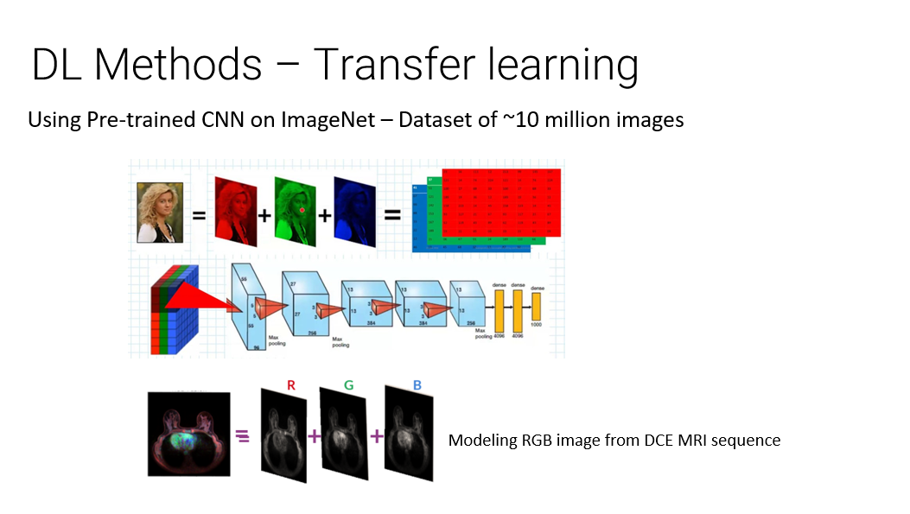

Slide 10
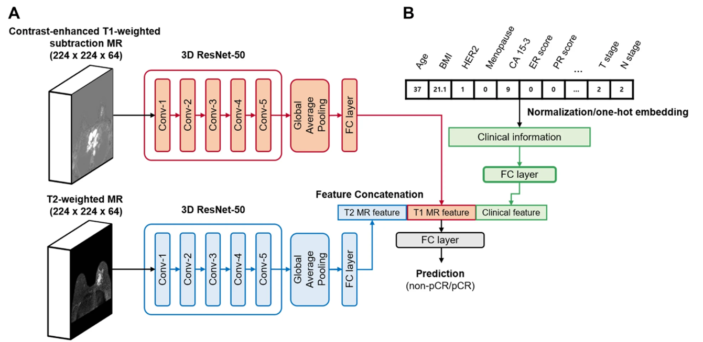
What a CNN can learn to see ?
PCR to NUC
Early detection of diseases
From MRI
From OCTA
From EKG
Heart daises from panoramic images
Heart disease from breast MRI
… Any labeled data

Slide 11
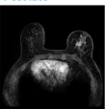
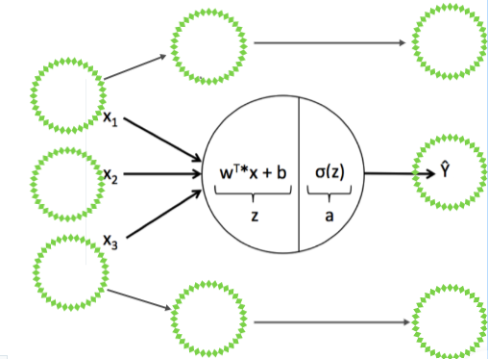
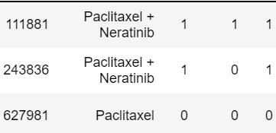
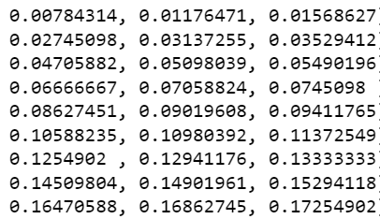

Data + Labeling → Deep Learning Model
Collect and label data + Build architecture + Train e architecture -> AI Model
Result is:
Trained Model
Predict with trained network, inference and validate against ground truth

Slide 12
Thank you ☺

